Slide 1
NetBox in a Cloud Native Environment
Moh Ahmed
May 19th, 2020

Slide 2
Agenda
Use Case Context
Cloud Native Overview
Operating NetBox
NetBox Automation

Slide 3

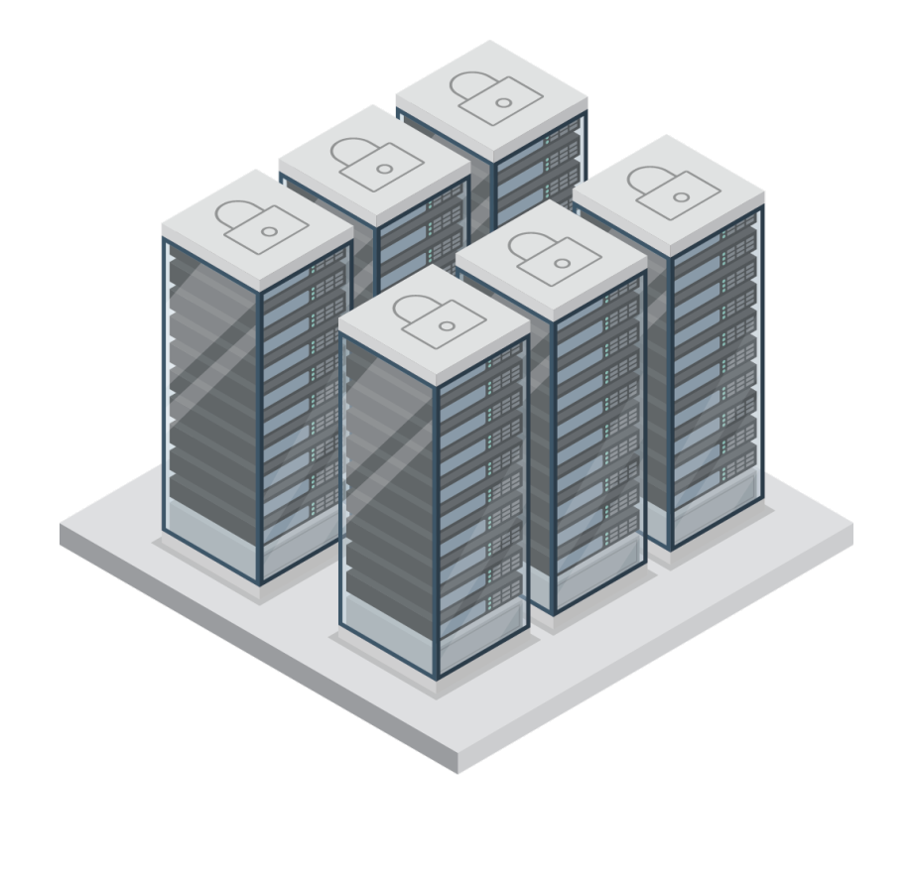

Use Case Context
<10 sites
10’s of tenants and virtual clusters
100’s of racks, device types
1000’s of
Devices, cables, interfaces
Inventory components
secrets, IP addresses, VLANs
High-Speed
Cloud Native
Virtualized
SDN/NFVI
Multi-Site
Multi-Vendor
Multi-Cloud
Public
Cloud
Security
Automated
Programmable

Slide 4
Containers Overview
Scalable and modular
Lightweight and quick
Convenient and portable
“Build once, run anywhere”
Deployment consistency
https://github.com/netbox-community/netbox-docker
Notes:
Break a complex application into its components, have a container for the database, the front end and the backend. This allows modularity in development, things can be modified in one container and not affect the other containers
Where virtual machines can be gigabytes in size with an OS, containers are usually within the megabytes range
Containers also require less resources in general to run as they don’t need resources for a complete OS
Since there is no OS to boot up, containers can start up incredibly fast, usually close to the time it takes for the app within the container to start
There are endless times where small variations in different environments affect how a piece of software performs on different systems
Item developed for Debian might not work on RedHat Enterprise Linux.
Software built with a package of a certain version may break when there is an update
Containers “contain” the application and all the dependencies/libraries required for the application to run. This means that in theory it can be brought into any container environment running on any system, allowing them to be deployed consistently every time
The Open Containers Initiative was a standard that was introduced to allow for interoperability and accessibility across various platforms and cloud providers
Docker is the most popular implementation of containers, there are others like CRI-O and RKT
Docker created docker hub, the “app store” of containers
A good reference for containers and its terminology: https://developers.redhat.com/blog/2018/02/22/container-terminology-practical-introduction/

Slide 5
Kubernetes Overview
“Governor”, “helmsman”, “captain”, “pilot”
Founded by Google engineers in mid-2014
Inspired by Project Borg, an internal Google Project
Google donated it to CNCF 2015
Powerful container orchestration platform
Automated rollouts and rollbacks
Self-healing
Horizontal scaling
Much more
Notes:
Project website: https://kubernetes.io/
Greek for governor or helmsman
Google Borg was Google’s containerized application orchestrator
Some of the same engineers that worked on Borg learned a lot of important things from Google’s large-scale environment

Slide 6

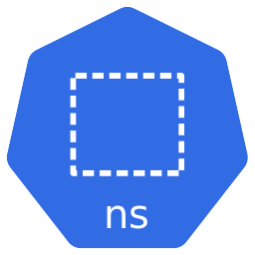
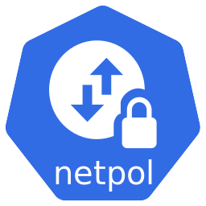
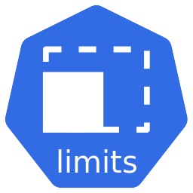
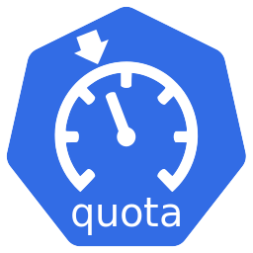
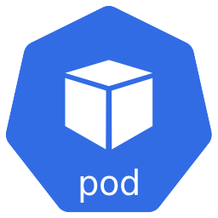
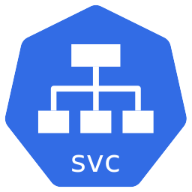
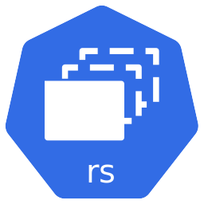
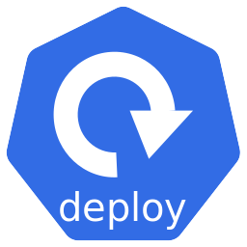
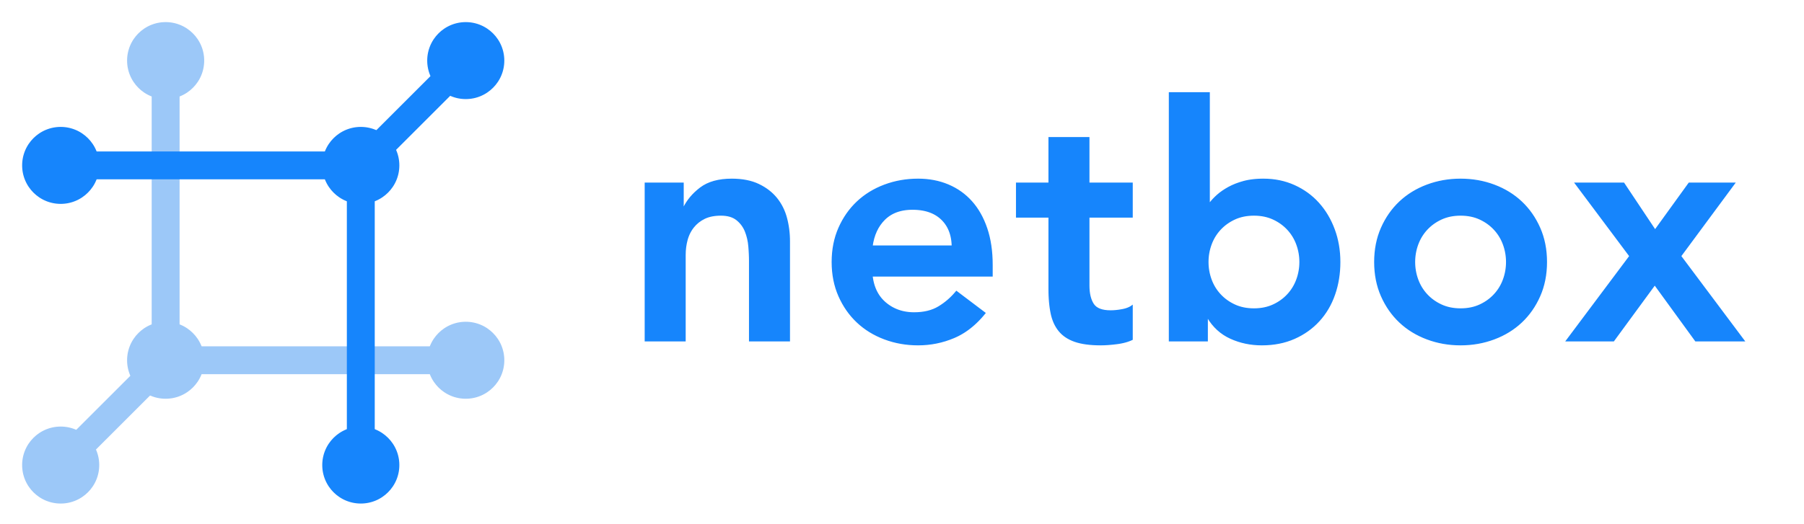
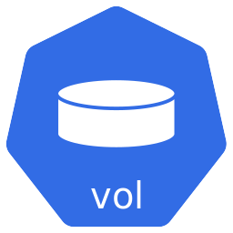
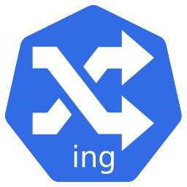
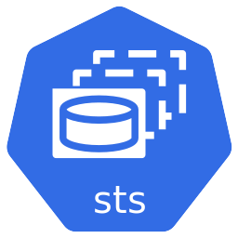
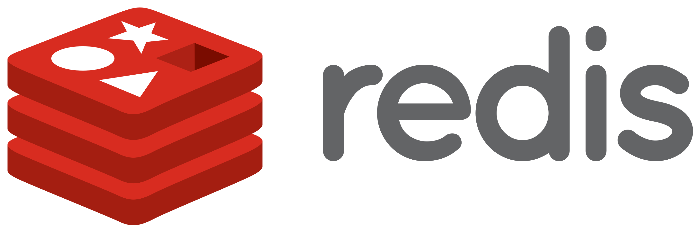
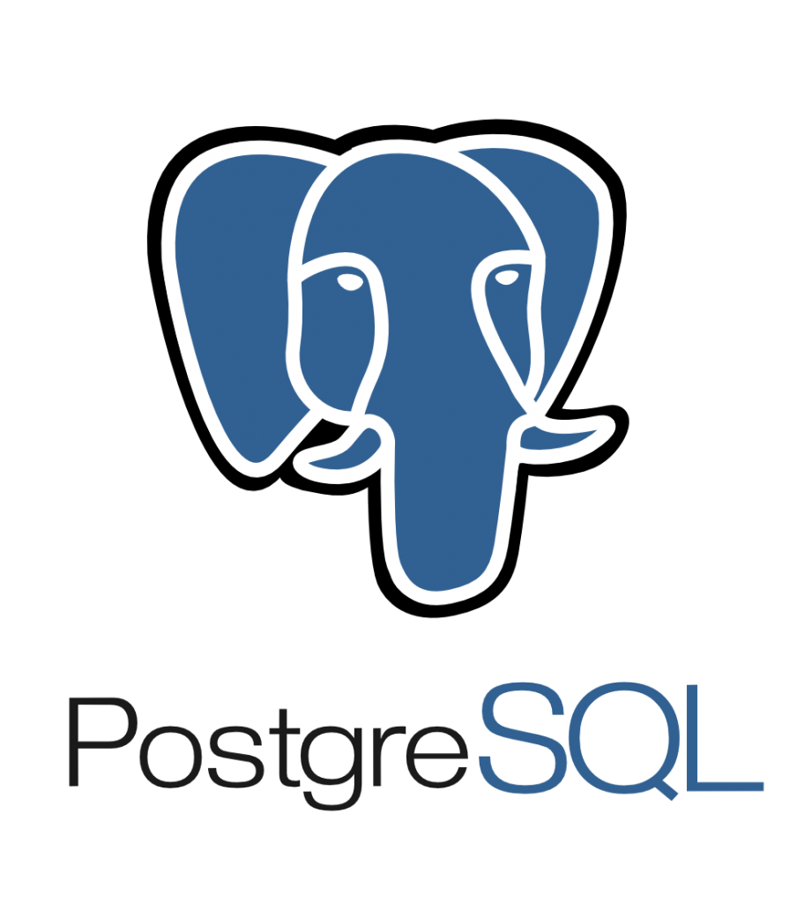
netbox.cengn.ca

Slide 7
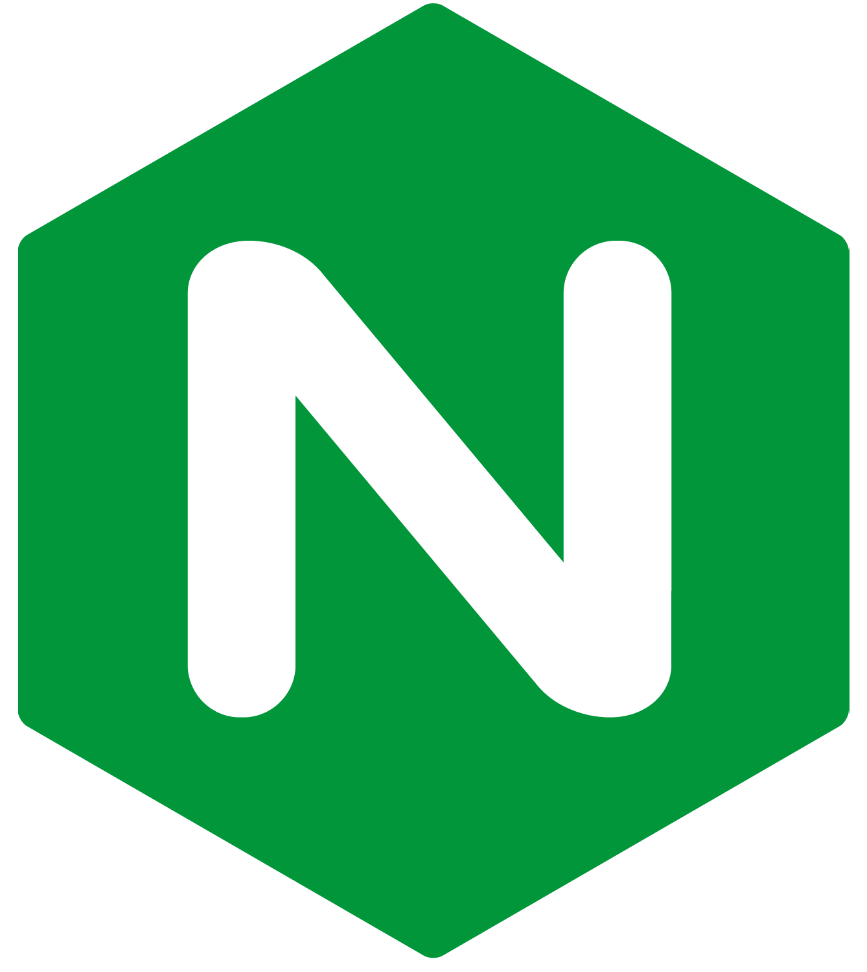
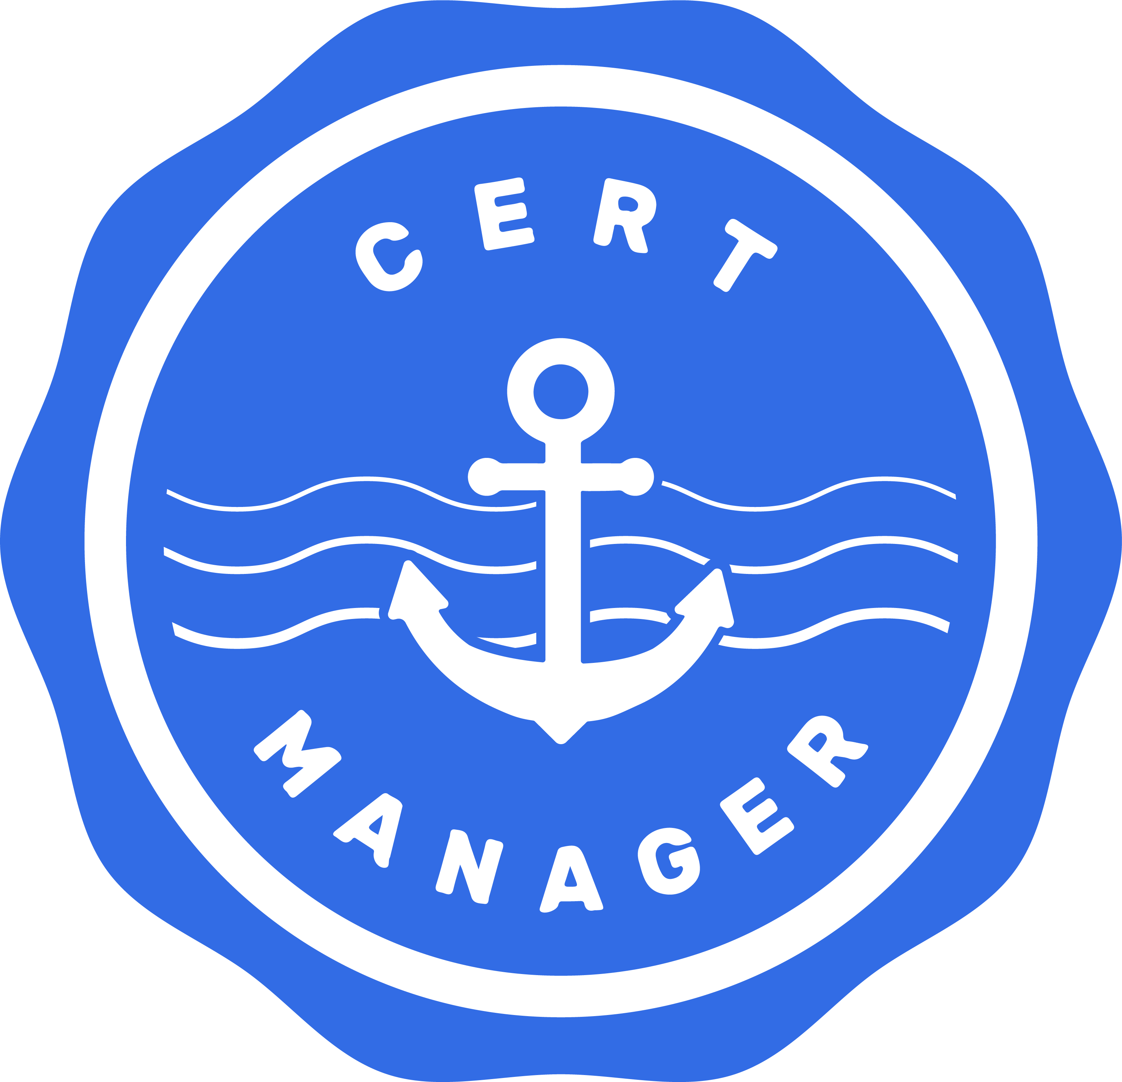
Nginx-Ingress & Cert-Manager
Nginx-Ingress is used as a reverse proxy into the cluster
Cert-Manager is used in combination
Automated SSL certificate generation
Automatic certificate renewal

Slide 8
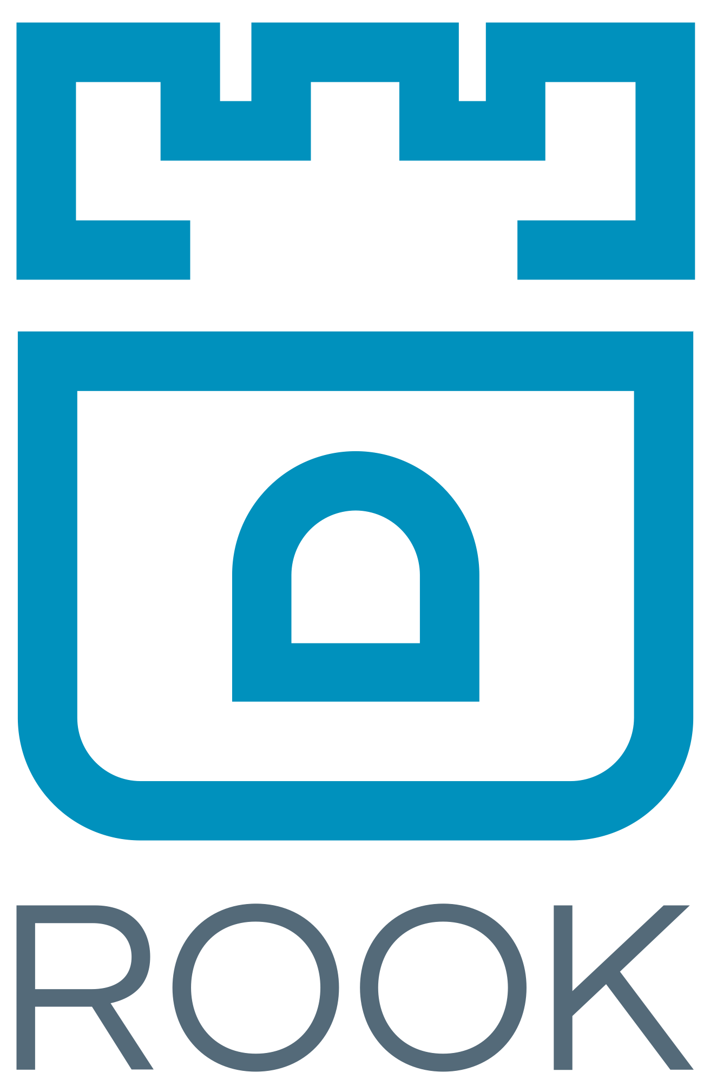
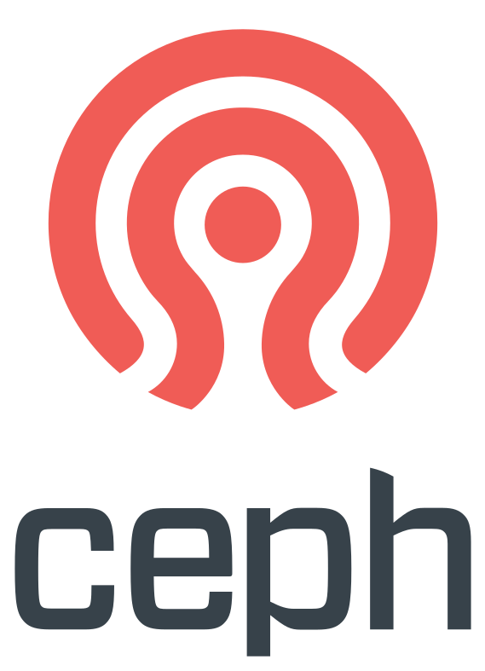
Rook-Ceph Storage Provider
The Rook operator provides a cloud-native way to deploy Ceph
Ceph provides resilient, distributed storage
Ceph shared filesystem was leveraged
Multiple NetBox instances sharing a single file storage
Allows for a distributed, highly-available NetBox service

Slide 9
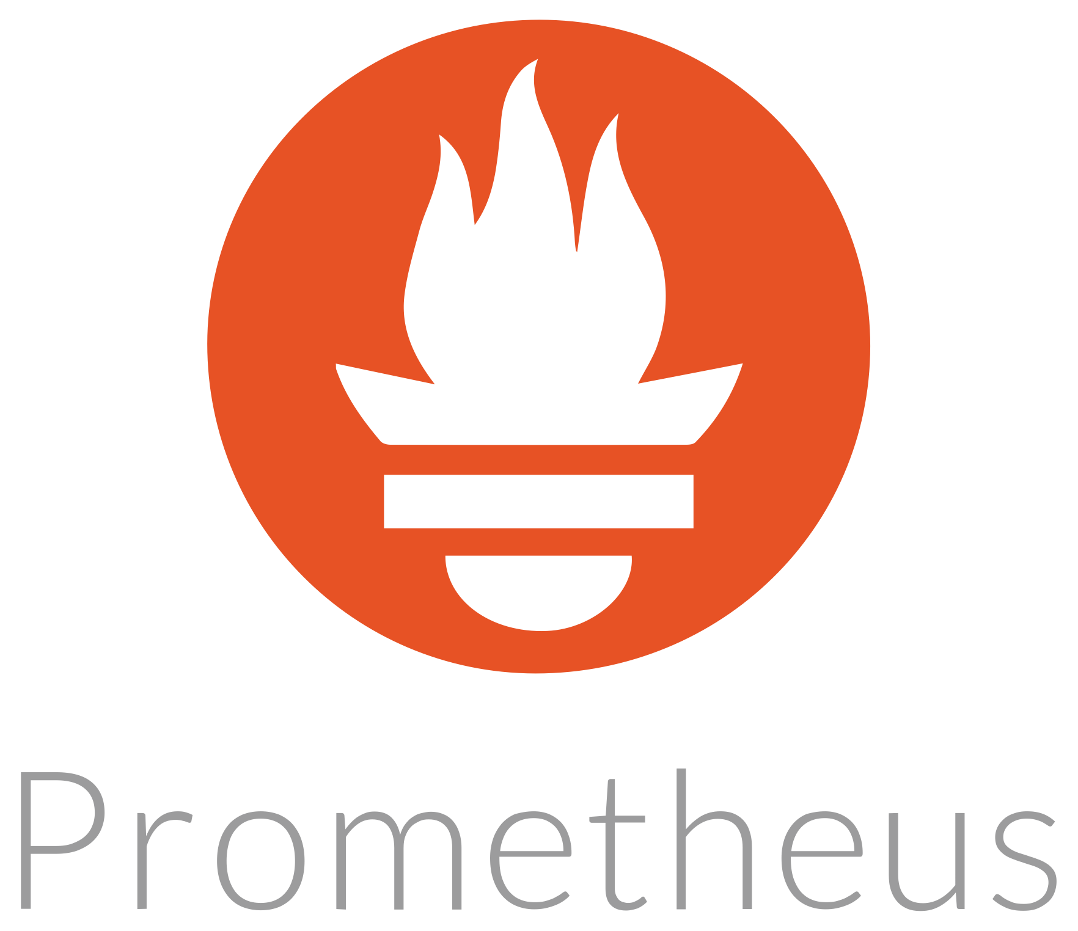
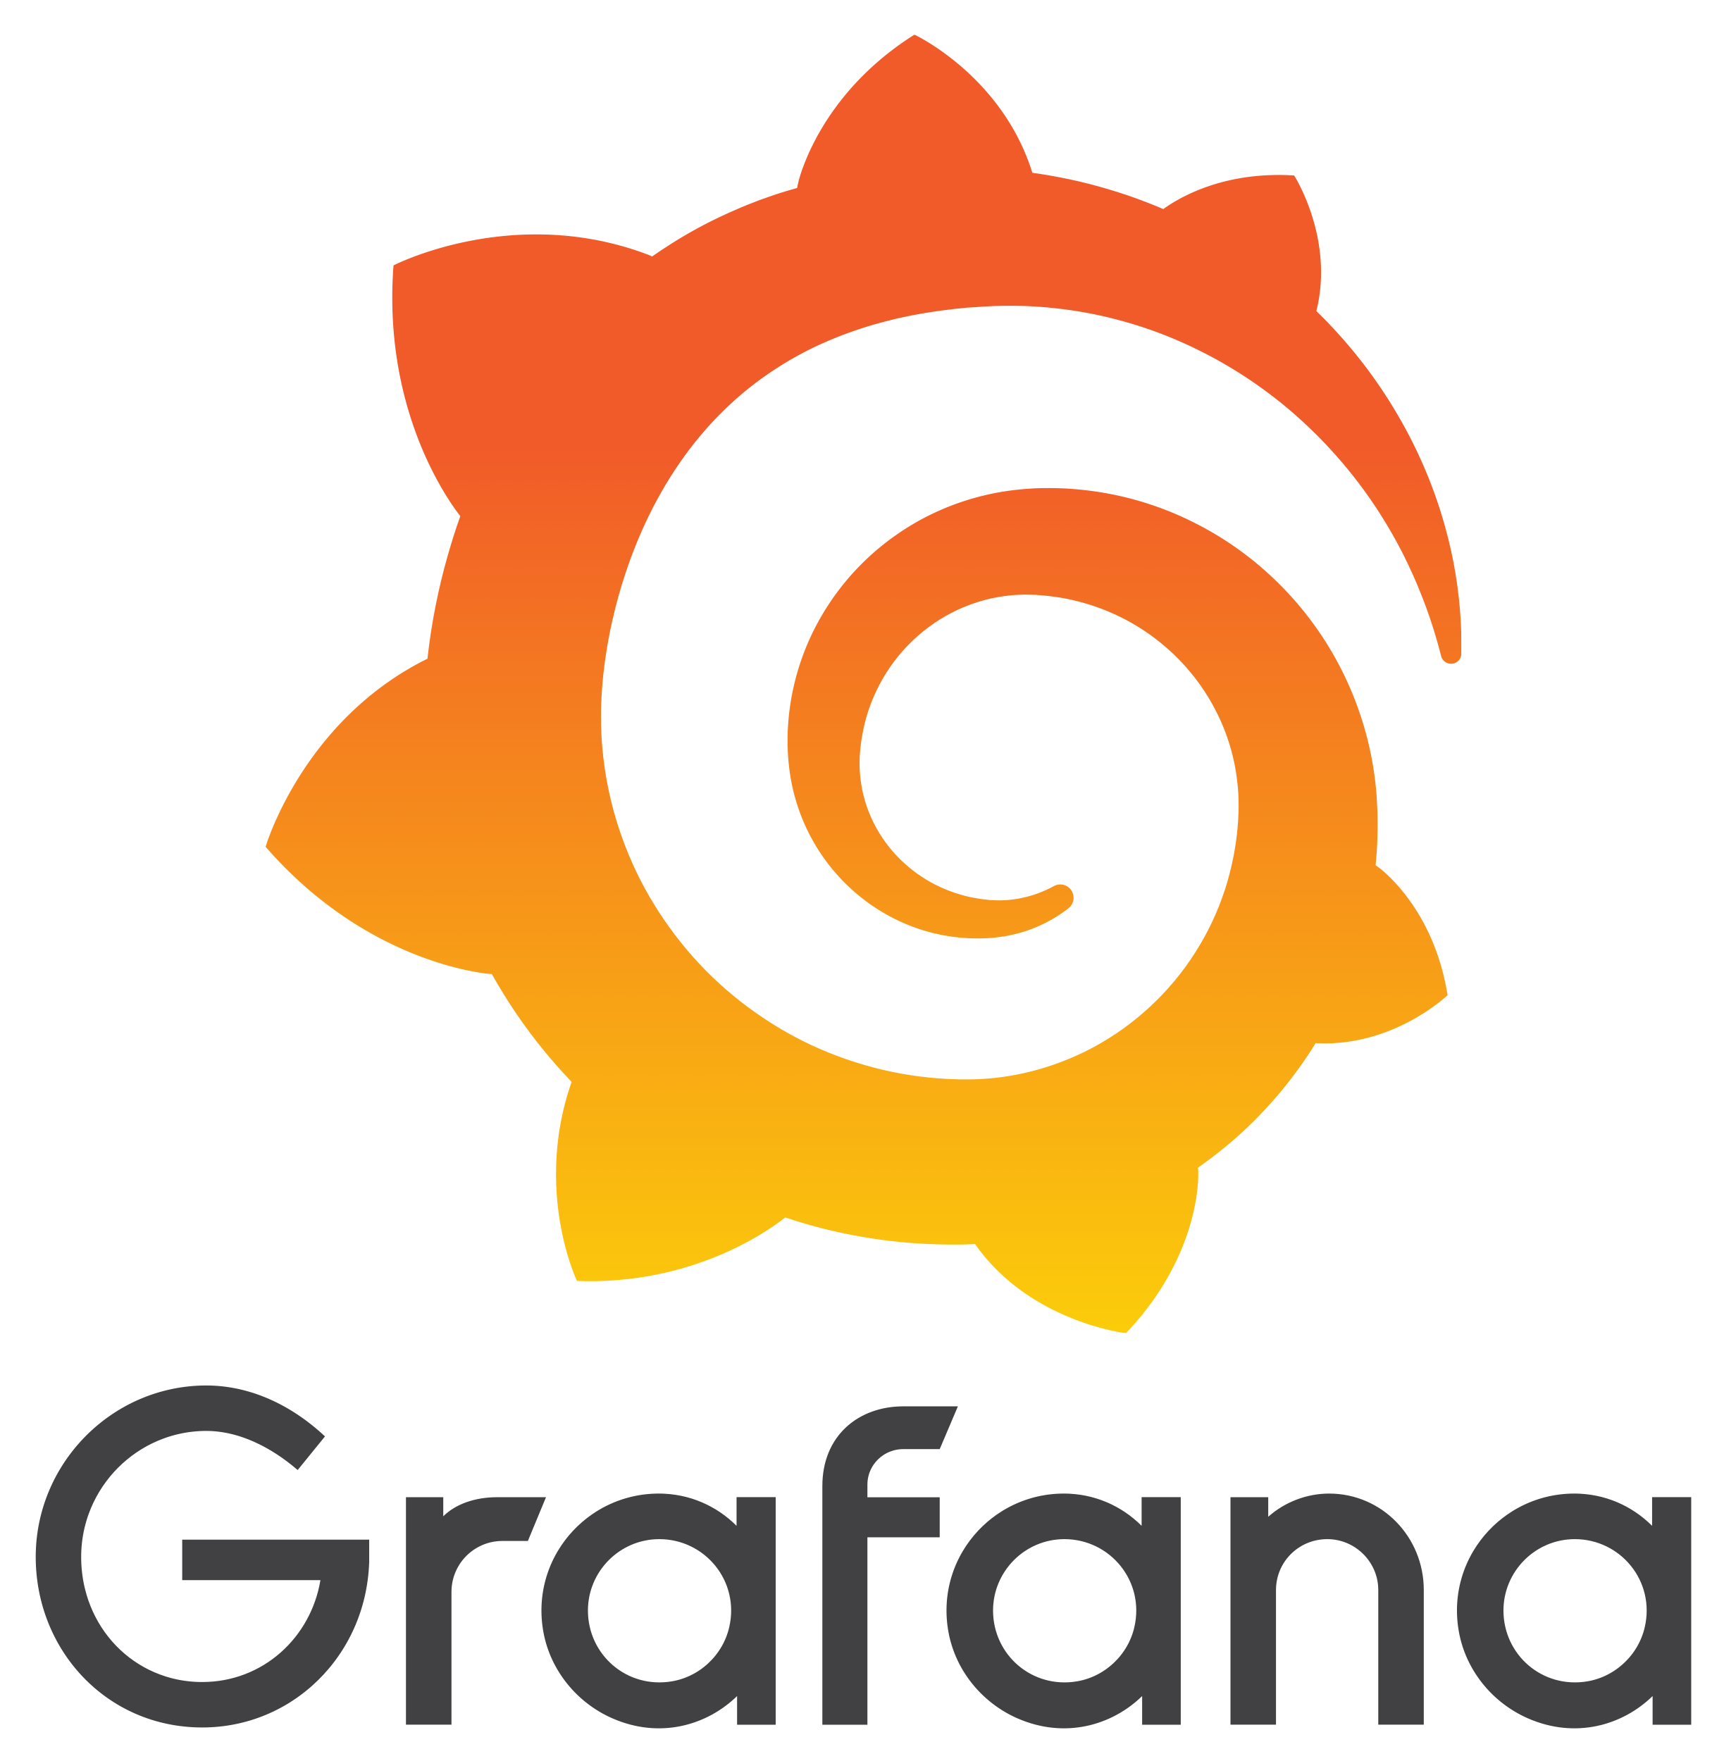
Built-In Monitoring
Various aspects of the service can be monitored and alerted on:
NetBox service availability
Ingress traffic
Django metrics

Slide 10
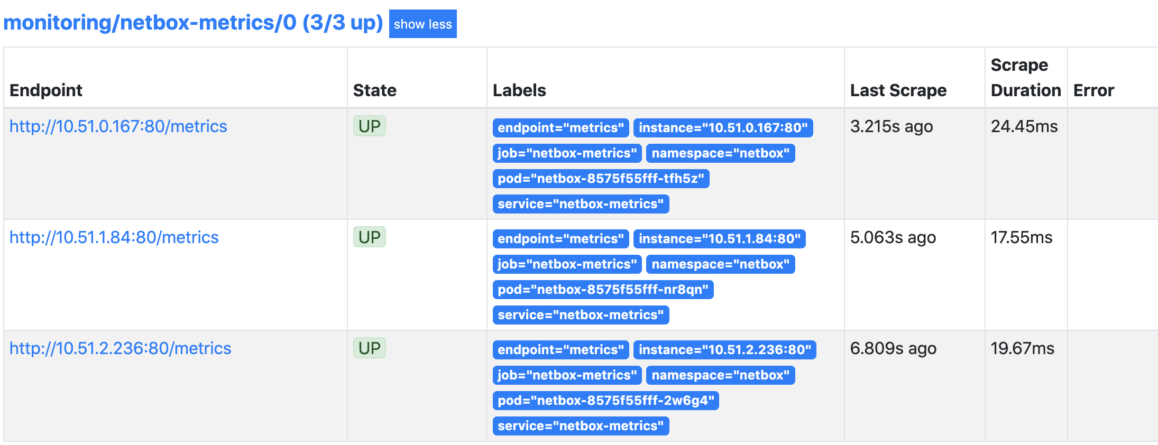
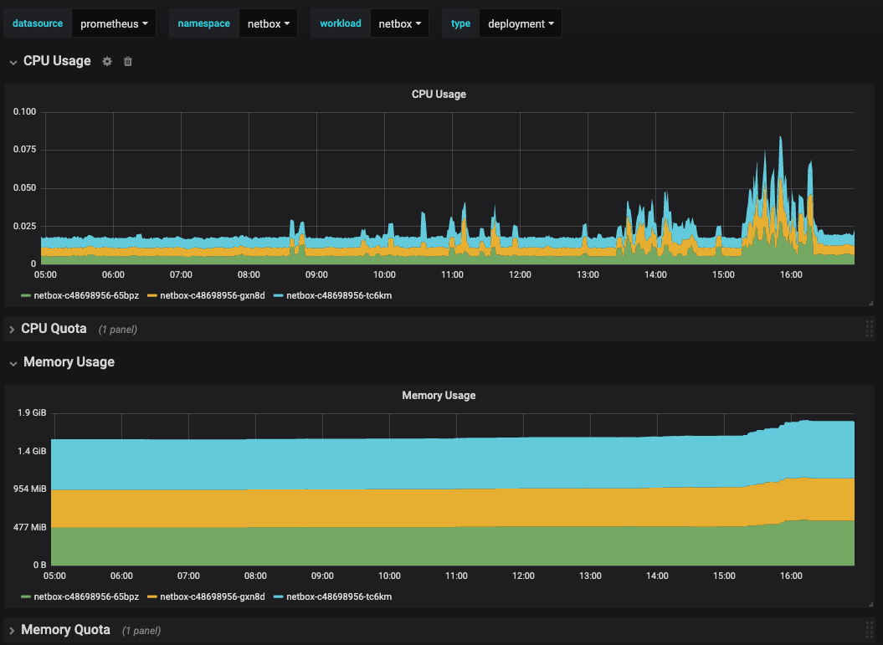
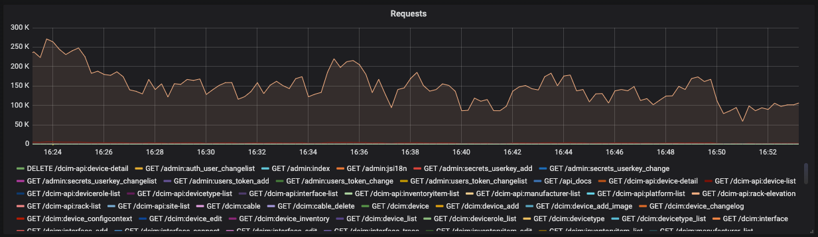
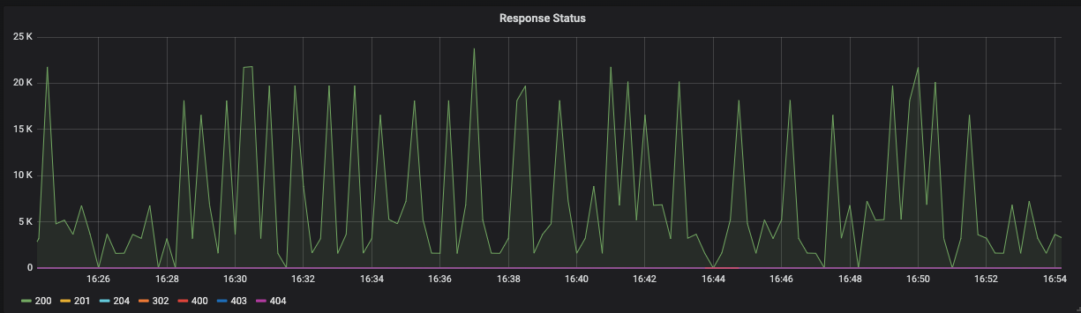
Example Dashboards

Slide 11
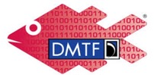
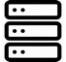


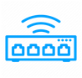
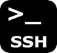
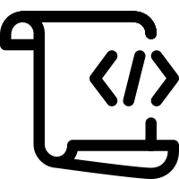

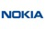

NetBox Automation
SERVERS
PyNetBox
REDFISH API
NETWORKING
DEVICES
PARAMIKO

Slide 12
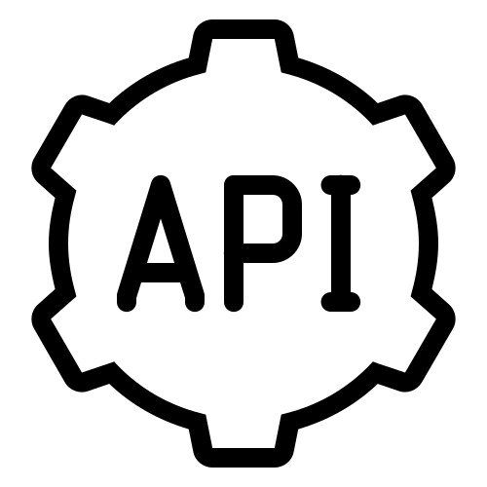
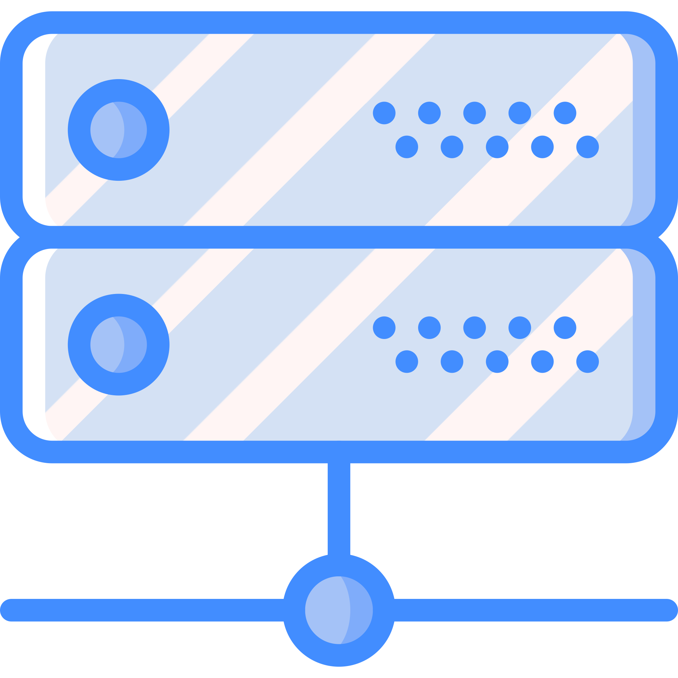

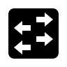
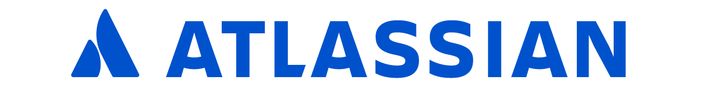
NetBox Automation

Slide 13
THANK YOU

Slide 14
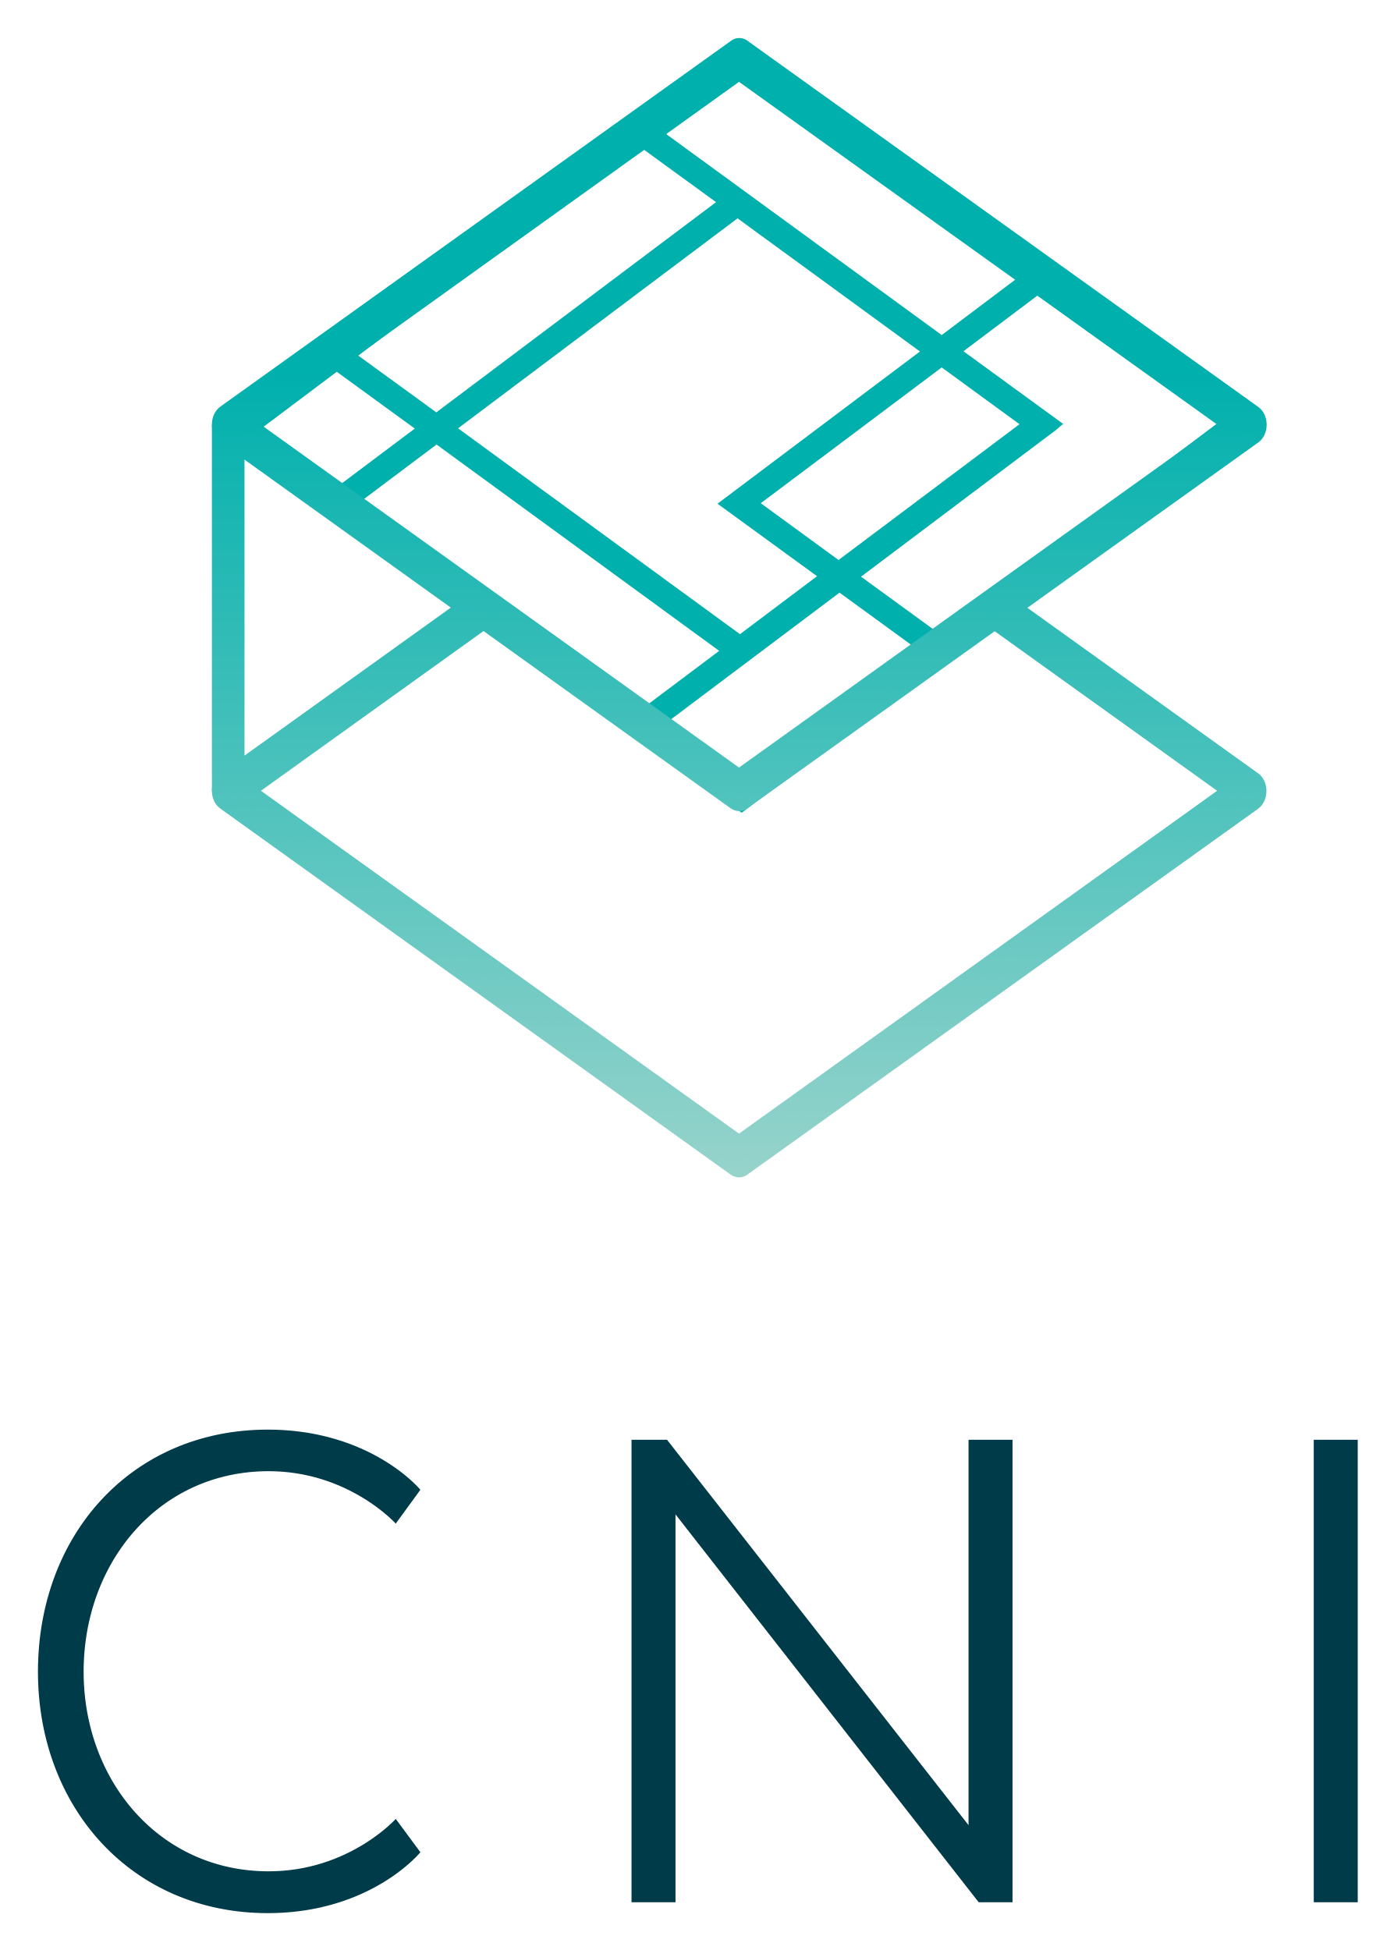
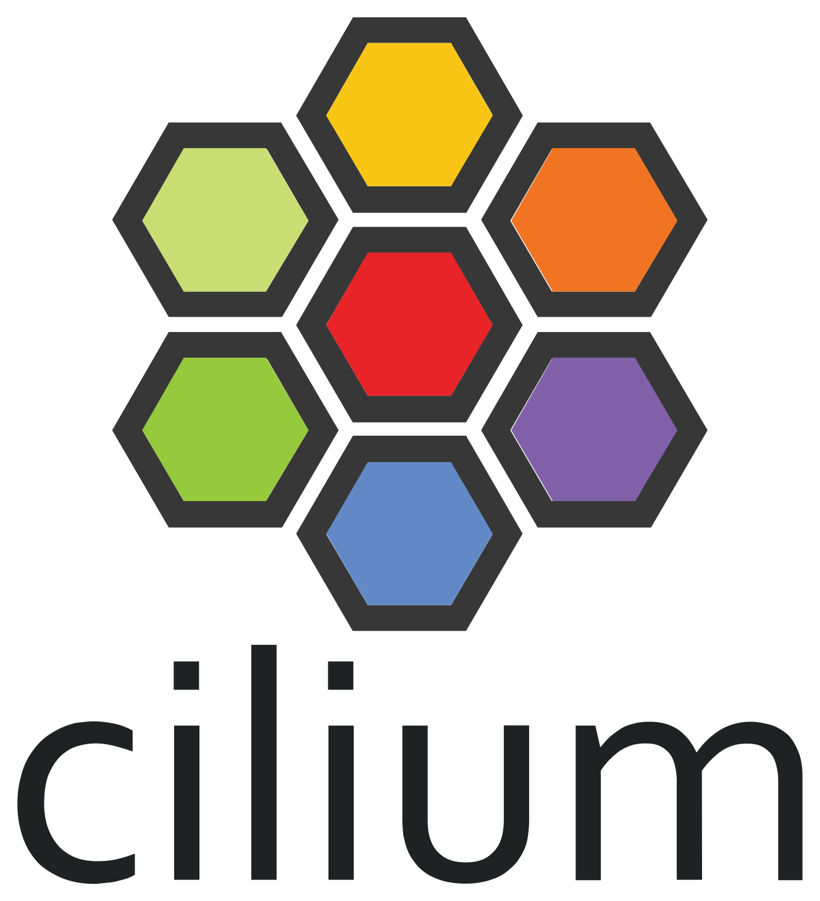
Cilium – CNI Plugin
Cilium is the Container Networking Interface (CNI) used in our cluster
The Cilium Network Policy resource is leveraged for security
Expands the built-in functionality to Layers 3-7 for ingress and egress traffic

